Slide 1
Horizon2020- Funding opportunities for Health Tech start-up's and SME’s
Waqar Ahmed, Head of EU Program
Norway Health Tech

Slide 2
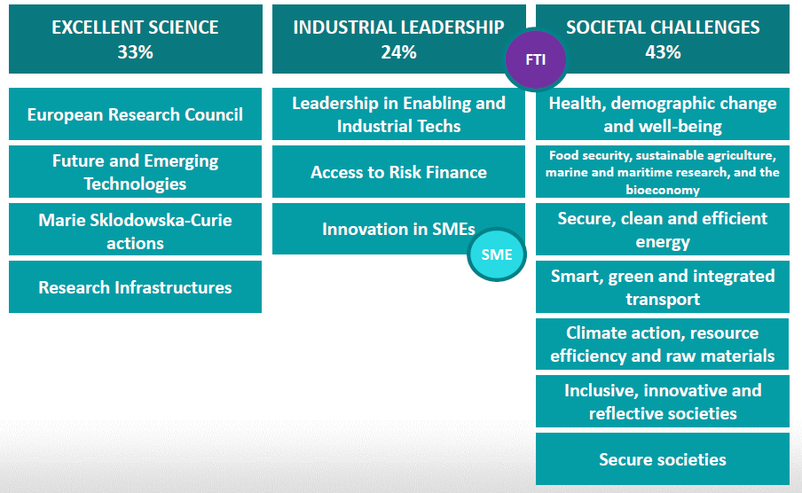
EU Framework program – Horizon2020
Horizon 2020 is the biggest EU Research and Innovation programme ever with nearly €80 billion of funding available over 7 years (2014 to 2020)

Slide 3
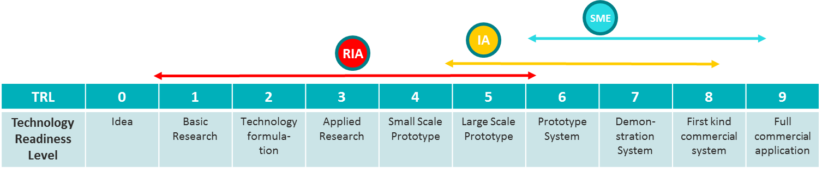
Project and Project evolution - Where is the idea situated
End Users
Hospitals, Health Authorities, regions, patients
Buyer
Medtech companies / Distributiors
Marketing
HTA agencies, health insurances
HTA, reimbursement
EMA, national agencies
Regulatory
approval
CMO, OEM
Manufacturing
Clinical
validation
Hospitals, CROs
FDA
CE marking
Notified bodies
Technology
development
RTOs
Basic research
Universities

Slide 4
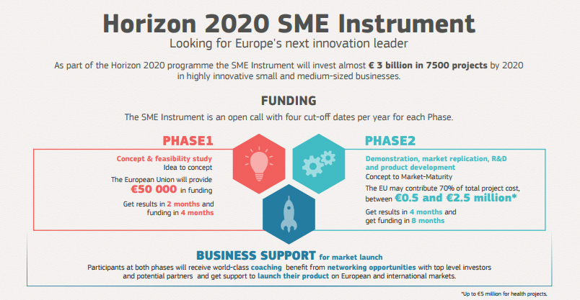
Notes:
Et europeisk akselleratorprogram
Fase 1:
Behov for å avklare realismen i forretningskonseptet: Fins det et reelt kundebehov i markedet? Dekker løsningen dette behovet på en tilfredsstillende måte? Er kundene villige til å betale for løsningen? Er ressursene som trengs for å utvikle og kommersialisere løsningen tilgjengelige?
Risikovurdering
Finne partnere for å styrke ideen
LEVERANSE: Mulighetsstudie/1st draft til Business plan
FASE 1 - Størrelsen på prosjekter og utbetalinger
Fase 1: Lump sum på 50 000 euro (70 % av pre-definert budsjett) Total: circa 71.000 €
Per consortium hvis flere deltakere
Forhåndsutbetaling av 40 %
Ingen detaljert oppstilling av kostnader (enkelt standardskjema)
Vise samsvar mellom aktiviteter og støttebeløp
Fase 2: Innovasjonsprosjekt
Demonstrasjon og testing
Produkt-/tjenesteutvikling (herunder designprosjekter og/eller samarbeid med pilotkunder)
Markedstesting
Bygge prototype
Produkt validering
LEVERANSE: Product klar til kommersialisering og en Business Plan.
Fase 2: Ingen nedre grense, men antydet prosjekter i størrelsesorden 500.000 euro og 2,5 mill. euro
Generelle finansielle regler gjelder
Ingen standard forhåndsutbetaling, forhandles (snitt 33%)
Interimutbetalinger
Fasene ses i sammenheng, men kan også vurderes uavhengig. Det er mulig å søke seg inn i fase 2, men man er sterkt oppfordret til å søke seg inn i fase 1
Etter fase 2 forventes at produkte er klar for å kommersialiseres, første kundene er på plass og selskapet har tilgagn til risiko kapital.
Med fjerning av tematiske utlysninger vil det være enda viktigere å presentere et godt business case for å nå frem.
Terskel: 13 poenger.
Innovasjon Norge offers SoE finansiering
Seal of Excellence fra Kommisjonen: Et dokument
Seal of Excellence fra Innovasjon Norge: Nasjonal støtte til de fase-1 prosjekter som kommer over terskelverdi (13 p), men som ikke oppnår EU støtte pga for stor konkurrensen om EU-potten
Dette gjør Innovasjon Norge for å stimulere selskaper å gjennomføre prosjektet og søke videre til fase 2.
Endringer i søknadsprosessen for fase 2.
Søknader med god score inviteres til Brussel for pitching og intervju med investorer
High level panel (5 deltakere, 6 panel i alt)
Gir enten tommel opp eller tommel ned etter pitching
10 min pitch, 20 min Q&A
IN kommer til å tilby pitchetrening
Større budsjett
Flere får sjansen til å komme til Brussel
120 inviteres ned (dobbelt så mange som det er finansiering til)
Må fortsatt ha en god søknad, trolig over 13 for å bli invitert
Hvis man ikke får finansiering etter pitch har man likevel fått presentert seg for et (high level) nettverk og potensielle kunder/investorer etter runden i Brussel
Frister : 4 per år

Slide 5
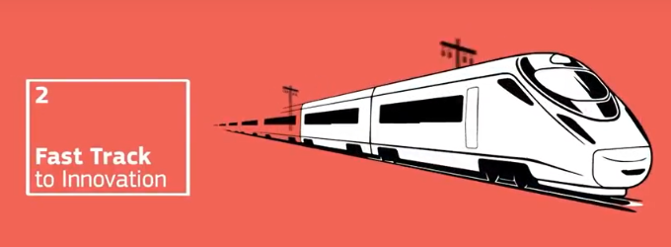
Fast Track to Innovation
Quick market uptake of new technologies – max 3 years projects.
Industry driven - for all kinds of innovation actors, trans-disciplinary and cross-sectoral cooperation
Fully-bottom-up innovation support programme
Who can participate?
Consortia: 3 to 5 legal entities from at least 3 different EU Member States or associated countries
All types of participants
This industry involvement implies:
  Either 60% of the budget allocated to industry participants in the consortium,
  or the presence of a minimum number of 2 industry participants in a consortium of 3 or 4 partners,
  or of 3 industry participants in a consortium of 5 partners.
Actions are to be ‘business-driven’
Grants: Up to €3 million per project
  For-profit entities will receive 70% co-financing
  Not-for-profit entities will receive 100% co-financing
Notes:
Pilot 2015-2016. Gjeninnføres fra 2018-2020
Aktiviteter:
Systemvalidering under reelle forhold/sertifisering
Testing
Pilotering

Slide 6
EU program of Norway Health Tech
Management & strategy of the Norway Health Tech EU program and team
Delivery of Granted projects
RDI collaboration
(Future Funding Stream)
SMEs Program
Cross4Health
INNOLAB
U-Test
- Rsearch and Industry collaboration
Cluster to Cluster Collaboration
Other collaborative actions
Company evaluation and EU funding strategy (SME Instrument, FTI and EUROSTARS)
Application development support
Financial and administrative support from the EU team of Norway Health Tech
Three full time employed in EU team today, with the strong Backoffice support from accounts and communication team

Slide 7
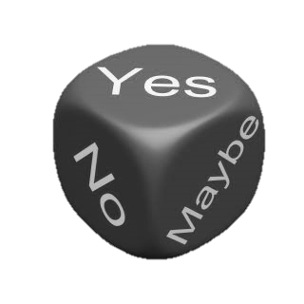
Variables of the funding process
Other external factors
Evaluation and Competition
Quality and relevance of the idea
Capability of Networks and Partners
The Writing Process
PREPARATION
Funded project

Slide 8
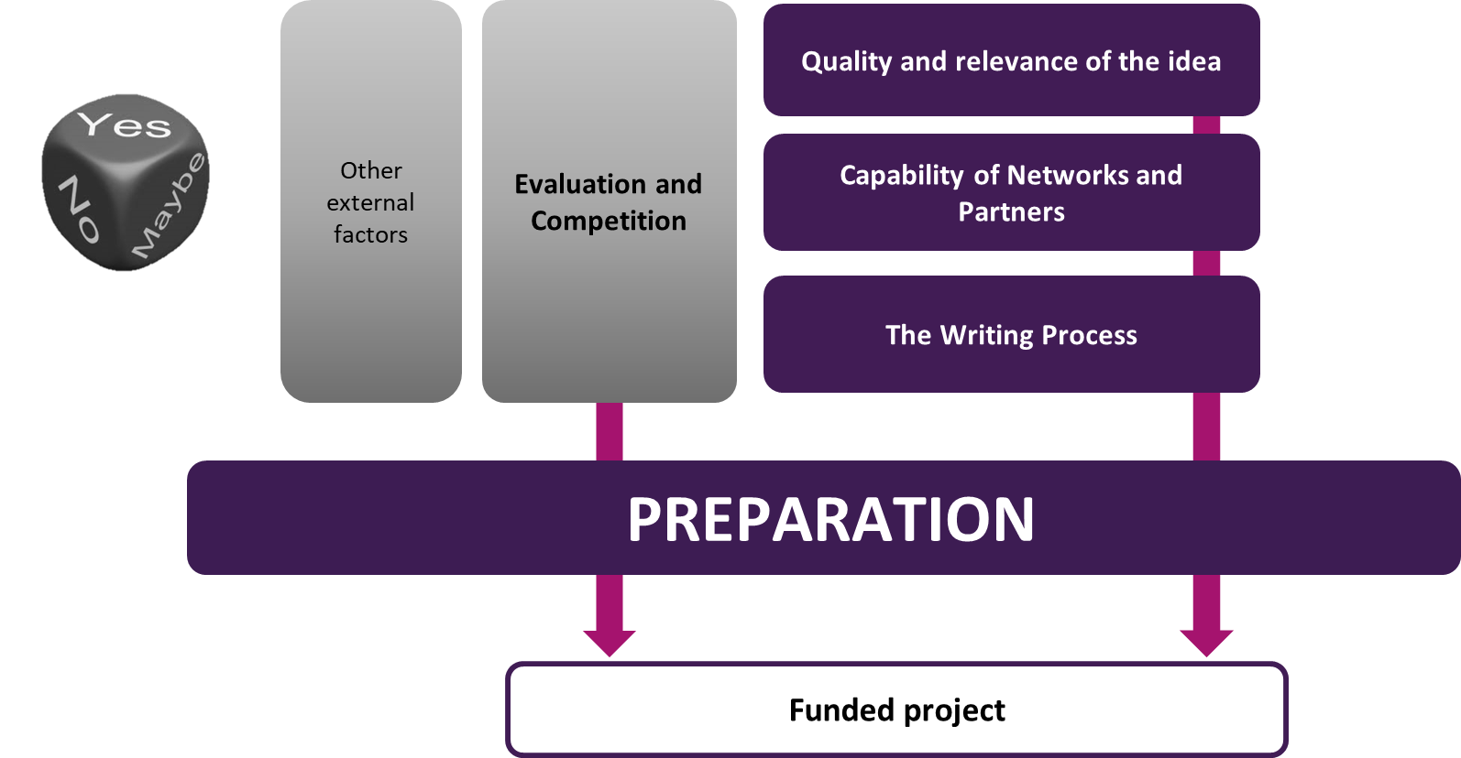
Variables of the funding process
Quality and relevance of the idea
    Study work programmes
    Validate your idea
    Dialogue with funding authority and peers
Capability of Networks and Partners
    Match resources
    Early engagements
The Writing process
    Organized and in time
    Project development tools
Evaluation and Competition
    Quality control /reviews
    Budgets expected

Slide 9
Norway Health Tech EU Program – Results
11 unique success stories in H2020 SME instrument and Fast Track Innovation
  Phase 2 and FTI: Biovotec, Respinor, Hy5 and Otivio
  Phase 1: Cardiaccs, ImmersoVR, Pubgene, Respinor, Hospital organiser, Respinor and Glucoset
  Total Grant secured: Approx. NOK 80 Million
7 unique success stores in Eureka EUROSTARS
  Otivio, Posicom, NeoRad, Hy5, Cardiaccs, Braive and Cardinor
  With an avg. funding of €1 Million per project, total grant secured is Approx. NOK 70 Million
  3 project granted in Research, Industry and cluster Collaborative programs
  Total Grant secured: NOK 133 Million of which NOK 76 Million allocated to Norway Health Tech, where NOK 50 Million reallocated to SME’s

Slide 10


H2020 Cascade funding to accelerate European SMEs in Healthcare sector
INNOLABS
Cross4Health
X industry
Health Tech
Mobile/Aerospace/Energy
X industry
Health Tech
ICT/Biotech/Medicine

Slide 11
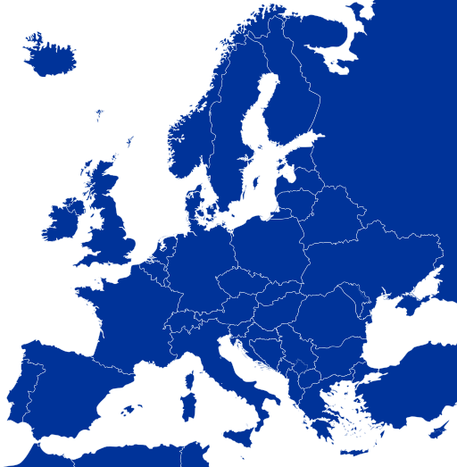









Corss4Health and INNOLABS - Cluster Facilitated Projects to Support New Industrial Value Chains in Healthcare sector
Funded by European Commission under H2020
Period January 2017 – February 2020
Lead by Norway Health Tech
Clusters participation from 7 EU countries
Sectors: Aerospace, Energy, Biotechnology, ICT and Medical devices
10M€ H2020 funding
7.5 M€ for direct SME support

Slide 12
What is happening, and upcoming opportunities
During 2017 we have worked across EU with 231 SMEs
  Service Hackathons , Idea Competitions, Webinars
  1st Open Call – 50 companies selected for the accelerator (26% from the Nordics)
Upcoming opportunities
  University student competition (Q1 2018), where we are looking for
    2-3 SME’s which can patronage university students
    Students who would like to work with companies
  Open Calls to join acceleration programs
    Q1 2018: to induct 20 SMEs in Cross4Health
    Q2 2018: to induct 25-35 SMEs in INNOLABS
  Service Hackathons – Q3 2018
  Open Calls to join acceleration programs
    Q1 2019 – to induct 40 SME’s in Cross4health

Slide 13
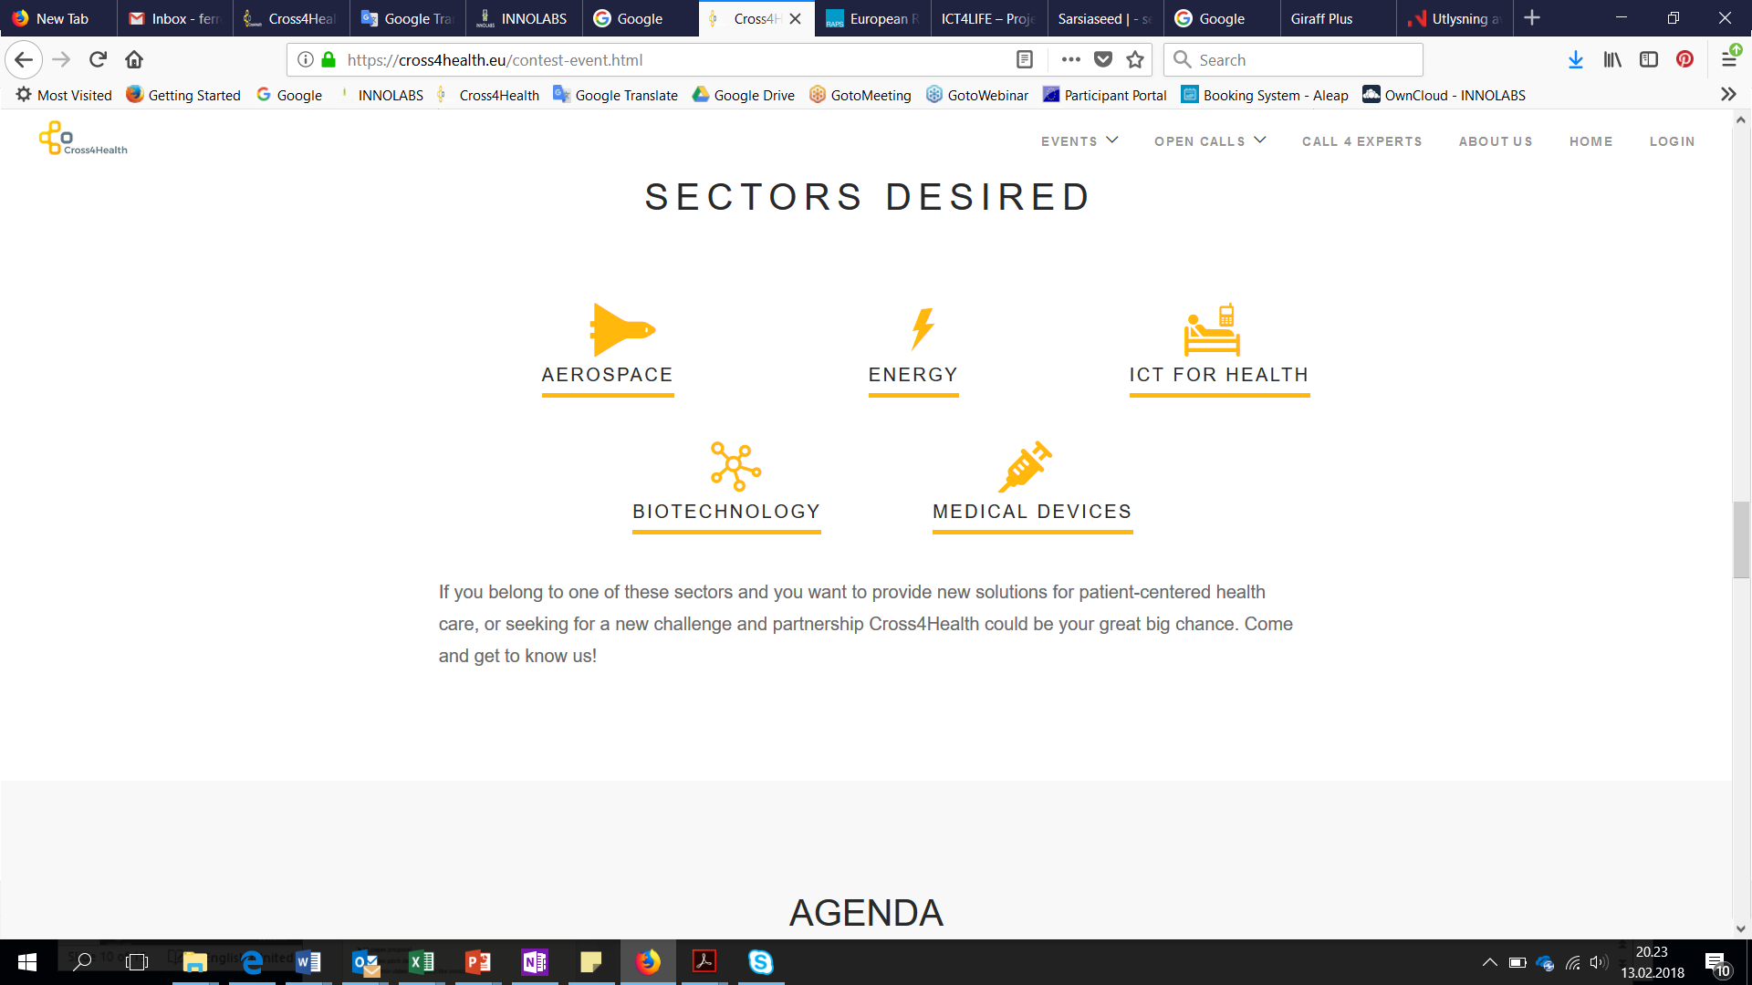
Open call to recruit 20 SME’s in Q2 2018
Healthcare challenges
Cross Sectoral collaboration
Provide safe remote care
Optimized care delivery workflows in hospitals
Faster process from sample to result
Team building support
15 Feb ‘18
July ‘18
April ‘19
Feb ‘20
16 May ‘18
Nov ‘18
FINAL EVENT
CROSS4HEALTH
Open Call
(Time to send proposals)
Acceleration process
More info: https://www.cross4health.eu/opencall.html

Slide 14
Acceleration Program
Supporting more than 200 companies across Europe
Key account Management
Business Development and Customers Workshops
Financial Support Beyond
Key Account Manager
Innovation Health Check
Service package design, follow-up
Product development road mapping
Public – Regional, National and EU
Pitch training
Private – Business angels / Venture Capitals
- Regulatory roadmap
Product Market fit
Go to Market strategy
Reimbursement strategy
A seamless services package - including services of consortium and third parties will be a unique value proposition offered to selected innovative projects.
IPR Consultancy, Regulatory assistance, Commercialization and market entry strategy
LEAN Business modelling and customer development, Technology transfer
Ethical and Legal Data Protection
Access to demonstration/living labs/end-uses facilities like hospitals, care centers, etc...

Slide 15

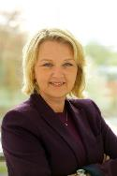
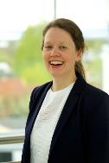






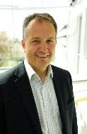



Our team
Kathrine Myhre
Anita Moe Larsen
Katrine Halvorsrud
Waqar Ahmed
Therese Eftevaag
Sergio Ferreira
Trine Radmann
New resource EU (50%):
Pavan
Mette Aastad
Herman Berg
Bent-Håkon Lauritzen
Odd Arild Lehne
Bill Harris
EU team of Norway Health Tech

