Slide 1
Funding & Growth
Norway Health Tech Seminar
1st MARCH 2018
Rannveig Fadum

Slide 2
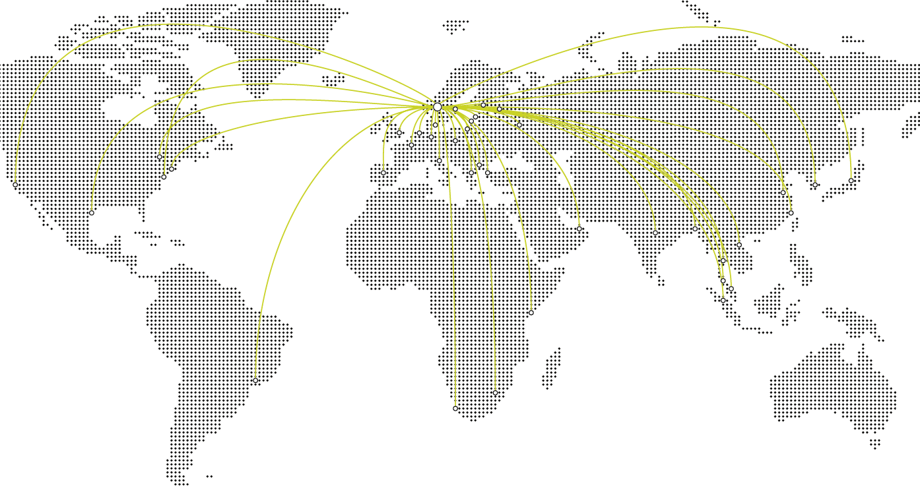

Innovation Norway
We give local ideas global opportunites
The Government’s most important instrument for innovation and profitable business development
Services intended to create successful entrepreneurs, more enterprises with capacity for growth and more innovative business clusters
19 offices in Norway, 35 foreign offices
Female CEO, Anita Krohn Traaseth
64 percent women leadership team
Notes:
Financial services
Advise
Mentoringe
Global competance programs

Slide 3

Today’s presentation:
Startup funding
- grants, loans, equity
Innovation Contract Program
Global Programs
Business Network

Slide 4


Slide 5
Startup funding

Slide 6

Startup Grants
  Market validation phase
  Up to 100.000 NOK covering up to 100 % of the external project cost
  Commercialisation phase
  Up to 600.000 NOK covering up to 75 %
  of the external project cost

Slide 7
Startup loan
Matching: 25 % (150.000)
Project 750 KNOK
Commersialitation
< 600.000 NOK
Market validation
< 100.000 NOK
or
Matching: 40 %
(1 MNOK)
Project 2.5 MNOK
Garanti: 20 %
Interest free: 2 yrs
Installments: 4 yrs
Startup loan
500 KNOK – 1.5 MNOK

Slide 8

Conditions for our funding:
Norwegian company, adding value to Norway
Innovation
Market potential
Profitable
Ability to complete task
Triggering effect

Slide 9
We do not give startup funding if
Payment problems, poor financial situation
Inventions lacking business sense
Company older than 5 years
Local focus – traditional commerce, private service, consulting, hand craft
Import, agencies or licensing businesses

Slide 10
Pre seed capital
Seed funds

Slide 11

Pre seed capital
The aim is to make the companies ready for larger investments
For innovative companies with growth ambitions, younger than 5 years
The capital are managed by intermediaries
The intermediaries do the selection for investments
Pre seed is invested as equity or convertibles
Up to 3 mill NOK per company, to be matched min. 50 % with private capital
Companies looking for pre seed capital should contact the intermediaries directly
The companies should prepare properly. The pitch and investor deck matters!
Notes:
Utløse privat kapital gjennom risikoavlastning

Slide 12
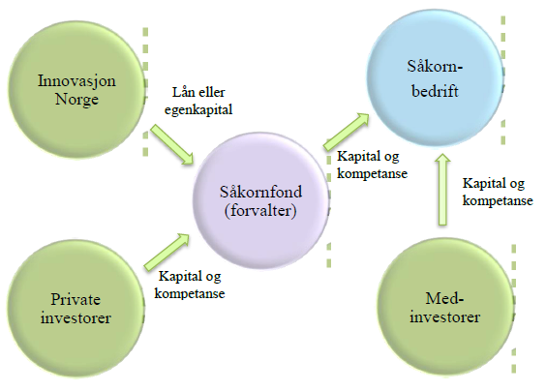

Seed funds
Company
Fund
management
Co investors
Notes:
Utløse privat kapital gjennom risikoavlastning
Totalt 3,335 mrd. kroner, herav 1,562 mrd. privat kapital (46,8 %)
Nå tilgjengelig ca. 1,0 mrd. kroner for investeringer i nye selskaper
Investert i 148 porteføljebedrifter
Statsbudsjett 2017 – foreslått ett nytt fond på 250 mill. kroner der IN går inn med 50 % av beløpet

Slide 13
Risk loans

Slide 14
Risk loans
Broad application offered nationwide across all sectors and industry
Top financing loans – supplementary to the private market
Profitable innovation and growth projects
Purpose: innovation, restructuring, growth and internationalization
Loans can be granted for investments in buildings, machinery, operational fittings, introduction of new technology, development, consultancy, market etc.
Notes:
Målgruppe: bedrifter med behov for risikoavlastning i investerings- utviklings- og vekstprosjekter – også til nystartede bedrifter. Kundens verdiskapning i fokus.
Toppfinansieringslån hvor IN har evne til å ta risiko som banker og andre kredittinstitusjoner normalt ikke tar
Vi er opptatt av våre kunders verdiskapning og ikke egen inntjening på risikolån!
Gode vilkår sett i forhold til risiko – lån kan gis selv om pantesikkerheten ikke er tilfredsstillende
Kan også gis til kapitalstyrking
Samarbeid med bank ønskelig/nødvendig i større prosjekter (risikodeling)
Betjeningsevne må sannsynliggjøres
Eierne må bidra - etter behov og evne
Lokal saksbehandling og oppfølging
Tap på risikolån dekkes gjennom egne tapsfond – vår rentemargin skal dekke adm.kost. – dette gjør at vi kan ta større risiko enn kommersielle aktører
Vi priser ikke risiko – flat rente på alle lån.
Lån inntil 2,5 MNOK kan i prinsippet gis uten pantesikkerhet – lån utover dette skal ha betryggende sikkerhet for deler av lånet.
Rentefritak/avdragsfrihet | ettergivelse
Når risikoen i et prosjekt deles med en annen bank og eierne i bedriften er det ofte lettere å få gjennomført prosjekter på en god måte.

Slide 15

Value proposition
Risk loans are offered as top financing
on favourable conditions
4,45 (4,70%) – interest free periods may be granted
Normally up to 50 % of capital requirement
Repayment period up to 10 years
Grace and interest free periods can be offered
Collateral normally secured in the assets of the borrower
Notes:
Loans up to 50 MNOK (25)
Normally up to 50% of financing need
Moderate requirements in regards to collateral
50% av lånet kan være uten sikkerhetsdekning
Pricing - relatively favourable conditions
4,45 (4,70%) – interest free periods may be granted
Maturity – adapted to depreciation
Up to 10 years (15) – grace periods can be granted
Debt service capacity
Balanced Financing
Bank + IN + Equity

Slide 16
Innovation Contracts
Innovation through Collaboration​

Slide 17

Development in collaboration with the market
Offer: New/improved production/solution
Need: Not covered by already existing offer
Innovation Contract
Competent Norwegian supplier
Pilot customer
SME with
ambitions to grow
Marketdriven
innovation
Private or public enterprise
Level of Innovation
Market potential
Ability to complete
Sustainability
Value creation in Norway
Specifications
Referance
Market channel
Foto: CC by o5com
Notes:
17
17
And this is the modality. It’s easy and difficult at the same time. It’s not just about signing an agreement, but about true and devoted collaboration.
It is a strategic tool for business development, where the point of departure is the market.
Pilot customer – specific need that is not being met by the existing solutions in the market.
Leading company, representing a larger market beyond this first demanding customer. Sentralt at kunden også bidrar med ressurser og kompetanse og er aktivt involvert i prosjektet. Thereby securing continuous trial and error and vailidation in order to hit the market with the best solution
SME: Is Innovation Norways customer. has the technology, competence and attitude to develop something groundbreaking. But sufficient market orientation, and the ability to hit the market with exactly what is requested/required/or needed, is still a challenge.
The scheme is applicable with a Industrial R&D partner, Norwegian or international, or a pilot customer from public Sector
Can be Public (PRD) or Industrial/private (IRD)
The key to this scheme is a the binding agreement between one or more suppliers and one or more pilot customers.
IRD or PRD Contract Regulates the collaboration – roles, responsibilities, IPR and rights to use the results.
It is the responsibility of the partners, but must be approved by Innovation Norway. And we supply templates and guidelines to assist.
IPR is an important part of this:
IN always require our companies to have a clear and defined IPR strategy– and in this scheme – we require the rights to be held by the SME. This is simply because we are not investing in a delivery or procurement between a supplier and a customer, but increased ability to grow, create value and competitiveness. The supplier company must have nessesary rights and control to scale and to further develop the solution at hand
IN: Finance, guidance and expertise, networking and competence to the table
But it’ not just about cooperation – but about development of a new solution! What we are looking for in order to take the project on board:
Level of innovation
Market potential – above and beyond
Capacity – financially, know-how and manpower
As in all IN initiatives, we need to see a high degree of value creation for the Norwegian SME and for Norway

Slide 18
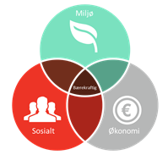
Financial support and balanced risk
Innovation Norway
Pilot customer
Supplier
Public support generally goes to the supplier company (INs customer)
Company Size | Small <50 | Medium 50-250 | Large >250
Experimental development | 45 % | 35 % | 25 %
Industrial research | 70 % | 60 % | 50 %
Collaborative bonus | 15 % | 15 % | 15 %
Grenser for statsstøtte følger EØS-regelverket
Notes:
When it comes to the grants offered by Innovation Norway – we support the supplier or provider
Support is based on the SMEs approved project costs (not total cost ) and follow EU regulations for RDI
The pilot customer must contribute with 20% of total project cost. We are mainly looking for the active involvement and manhours here
.
Maks støtteintensitet avhenger av bedriftsstørrelse og følger EØS regelverket. De aller fleste bedrifter faller innenfor maks 45% men det vurderes altså i hvert enkelt tilfelle hva som er nødvendig for å utløse prosjektet.

Slide 19
Global Entrepreneurship Program

Slide 20
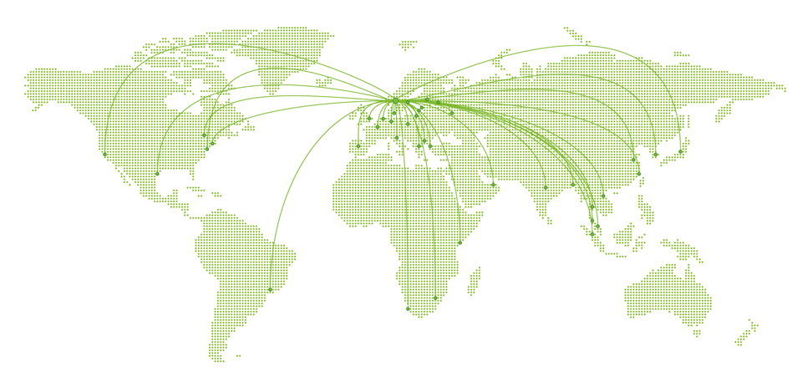
International learning arenas
GET Boston
Tech City London
TINC Silicon Valley
Entrepreneurial Marketing NYC
nHack Shanghai
Nordic International HUB
India
Global Services – Soft landing spots in international markets
Notes:
Siden 2012 (Boston fra 2010), pr. aug.-15 medregnet TINC SV og New York Marketing for høst 2015, som begge har kickoff i aug.15

Slide 21
GLOBAL ENTREPRENEURSHIP - 6 different programs
Basic training
Academic training
Market opportunities
Sales & marketing
training
Tech incubator
Executive accelerator
BUSINESS BOOTCAMP
GLOBAL ENTREPRENEURSHIP TRAINING
ENTREPRENEURSHIP IN EMERGING MARKETS
ENTREPRENEURIAL SALES AND MARKETING
TINC
TEA
Norway
(all regions)
Babson College
(Boston)
New Delhi
(India)
New York
(USA)
Silicon Valley & Singapore
London
(UK)

Slide 22
Global Growth

Slide 23

About Global Growth Program:
A series of export programs delivered by Innovation Norway to help Norwegian SME companies grow in international markets​
Increase speed and reduce risk when pursuing new, international business opportunities
Each program is tailor-made for a group of companies having products, services or technologies that solve problems in specific sectors or industries
The program normally lasts for 4-10 months involving 1-3 Gatherings in Norway and the same in the target market

Slide 24

Companies are clear on how we can assist them to grow and scale internationally
Need help to:
Understand opportunities,
barriers and challenges​
Get the first customers
on board​
Get in contact with potential
customers, partners and stakeholders​
BUT: you need to be prepared when you meet them, not to blow your chances once you open your mouth or show your material ; )
www.innovasjonnorge.no
Notes:
Oral​
10 sec. pitch to raise interest​
2-3 minute pitch with a couple of slides​
​
In writing​
One-pager (non-donfidential flier)​
Short slide deck​
​

Slide 25
Business Networks

Slide 26
Business Network - bringing companies together
Strengthen
the companies’
Cooperative ablility
Innovative capability
Competitive position
Value creation
Profitability
Notes:
Bediftnettverk er samarbeid mellom små og mellomstore bedrifter for å styrke bedriftenes:
• Samarbeidsevne
Innovasjonsevne
• Konkurranseposisjon
• Lønnsomhet
Stikkord er:
• Tydelige og felles mål
• Knyttet opp mot viktige utfordringer for deltakerne

Slide 27
The Business Network Program
Target group: Small and medium-sized companies
Strategic commercial collaboration - aiming at new business opportunities in markets abroad and in Norway
We offer funding (grants) - and professional support
Open call for proposal twice a year – deadline for application March 15, and September 15

Slide 28



Gründer - Innovasjon Norge
@RannveigFadum

