Slide 1
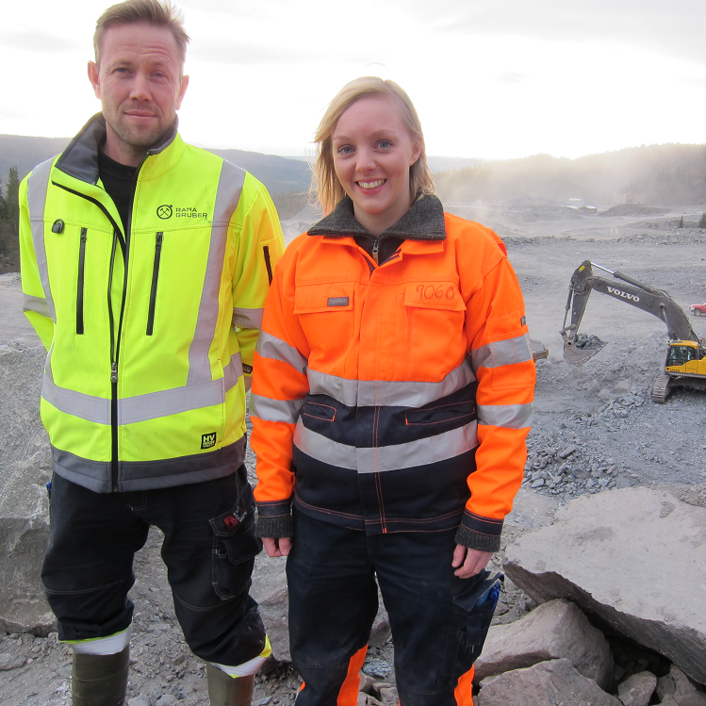
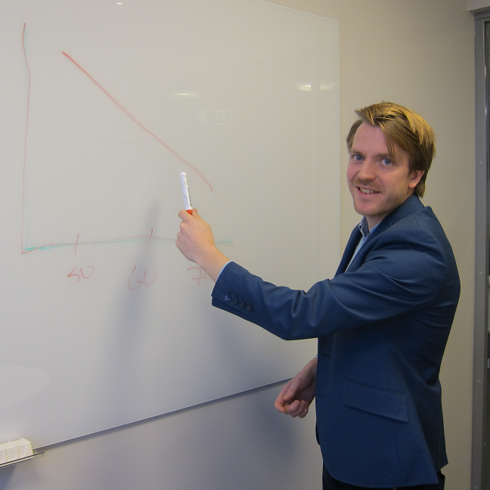
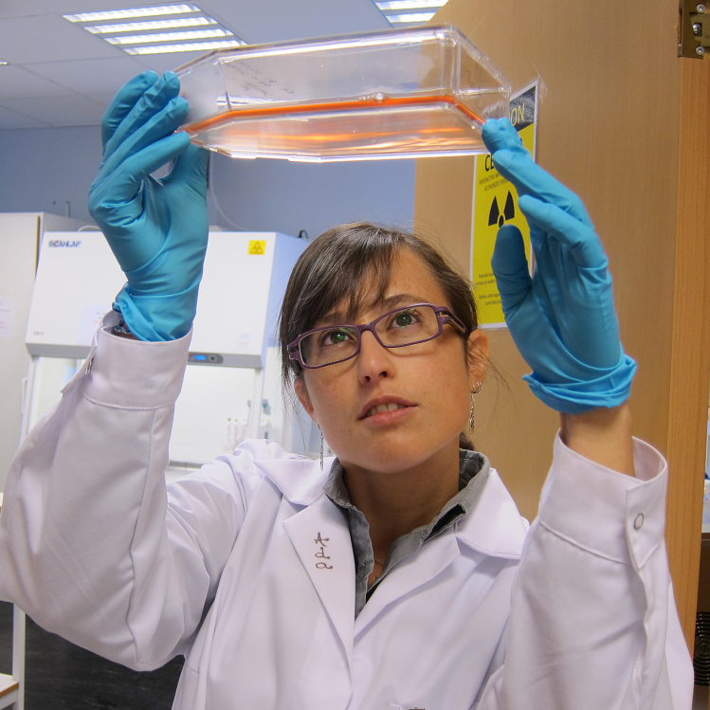
The Industrial Ph.D. Scheme
Siri H. Hollekim Haaland
Notes:
Good morning!

Slide 2
The Industrial Ph.D. Scheme has three objectives
to increase the recruitment of researchers to Norwegian industry
to boost long-term competence-building and increase research efforts in business and industry
to enhance interaction between academia and industry
Notes:
The Industrial Ph.D. Scheme was started by the Research Council in order to contribute to
increasing the recruitment of researchers to Norwegian industry
boosting long-term competence-building and increase research efforts in business and industry
enhancing interaction between academia and industry
The Scheme is funded by the Ministry of Education and Research and the Ministry of Trade, Industry and Fisheries.

Slide 3
An Industrial Ph.D. project is…
… a smaller research and development project carried out as a ph.d. project and conducted by a company employee.
… a project with clear thematic relevance for the company’s business activites, and initiated and carried out in line with the company’s needs.
the business
products and services
restructuring
Notes:
An Industrial Ph.d. project is a smaller researh and development project carried out as a doctorate conducted by a company employee
The project is relevant and tailored for the company, and may be related to for example
Strenghtening the core business and further develop new or existing ways of working and processes
Developing the services or products offered by the company
As a tool in periods of restructuring when there is a need for greater efficiency and profit, or to adapt to a changing market

Slide 4
An Industrial Ph.D. is a collaboration between industry and academia
Company
University / uni. college
The company is the project owner.
The project is planned and executed in collaboration with a degree-conferring university or university college.
The project is conducted by a company employee, who will then earn a doctorate degree.
Others may contribute as project partners.
Other partners
Notes:
The company is the project owner and the project partner
The project is planned and executed in collaboration with a degree-conferring university or university college, which ensures the project’s scientific merit and the research perspectives
The company does not have to have all the answers when approaching a university, but together with the academic partner figure out the project’s framework, research objectives and execution.
The company is free to choose which academic partner they wish to collaborate with, including institutions abroad
The collaborating academic partner will be the degree-conferring institution from which the candidates received his/her diploma
3. The project is conducted by a company employee, who will earn a doctorate degree
the role as a candidate can be taken on by a current employee, or someone recruited specifically for the Industrial Ph.D. project
4. Other actors may contribute as partners depending on the company’s project needs. These partners could be other companies, other universities than the degree-conferring institution, research institutes etc.

Slide 5
Industrial Ph.D. projects, by industrial area
Notes:
As you can see, pharmaceuticals, medicine and biotechnology is one of the biggest industry areas in our scheme.

Slide 6
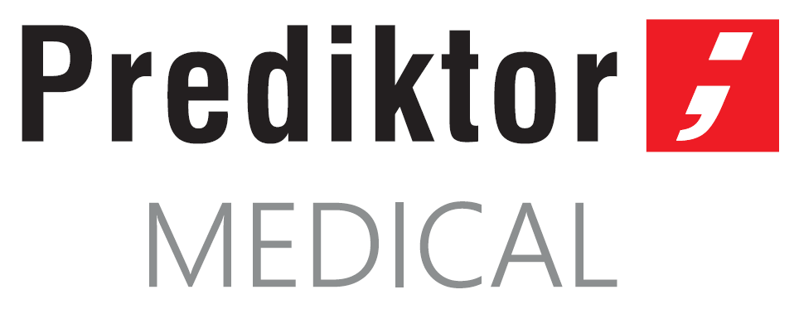
Notes:
And these are just some of the companies that have participated in the scheme. Both Nordic Nanovector and GE Healthcare are now running their second Industrial Ph.D. project with the previous candidate as a project manager.

Slide 7
Industrial Ph.D. projects, by subject area
Notes:
The Industrial Ph.D. Scheme is open to all subject fields, but is dominated by subjects within technology - this includes several projects within bio technology. Within mathematics and natural science we have projects within pharmaceutical chemistry, bio chemistry etc.
Meanwhile the field of health and medicine is dominated by clinical medical sciences, such as oncology, and health subjects, such as nutrition.

Slide 8
Different companies, different needs
R&D experience
R&D for less
connecting projects
Notes:
Companies starting an Industrial Ph.D. do so due to different needs, and for different reasons:
Companies that do not have a strong R&D culture may use an Industrial Ph.D.
as a starting point and as a learning arena when it comes to running your own R&D project
and as a way to broaden its academic network.
Several of our companies have started in the Research Council with an Industrial Ph.D. project, and moved on to projects within the larger thematic programmes.
For companies with limited R&D funds an Industrial Ph.D. becomes a larger project which can be productive when it comes to both the research results and boosting the long-term competence in the company
Companies that are already strong when it comes to R&D may use an Industrial Ph.D. project in different ways:
an Industrial Ph.D. can be connected to a larger R&D project, already funded by for example the Research Council.
Some companies run several Industrial Ph.D. project at the same time, with the candidates supporting each other and collaborating.

Slide 9
The value of an Industrial Ph.D. project
the R&D results
increased research competence in the company
strengthened ability to innovate and compete in the market
(broadened) network in academia
innovation
Notes:
In addition to R&D results produced in the project the company has the opportunity to
Increase its research competence – in addition an Industrial Ph.D. may be used to recruit talent or retain highly qualified employees
Companies that invest in R&D gain a competitive advantage and an ability to innovate which is beneficial to the companies market position
Broaden its network in academia and use the project to continue already fruitful relationships
Our companies report strong innovations results – the past two years our Industrial Ph.D. projects have reported approximately 250 innovation results including new products, services, processes and business areas. Also, 7 new companies have been registered as a results of an Industrial Ph.D. project, and they have applied for 30 patents

Slide 10
Funding
the Industrial Ph.D.’s total basic funding is approximately 1,6 MNOK, distributed yearly throughout the project period
SMEs can apply for additional lab funding (max. 600 kNOK)
personal overseas research grants are available to candidates
open-ended deadline
Notes:
We offer a maximum basic funding of approximately 1,6 million kroner – the yearly amount cannot exceed 50% of the projects costs.
SMEs may apply for addtional lab funding of no more than 600 thousand kroner – this is to cover expensive lab activites and cannot exceed 50% of the lab costs.
We also offer a personal overseas research grant for candidates who wish to conduct parts of the research abroad.
Our deadline is open-ended and we reccomend applying at least two moths before planned start-up date.

Slide 11
Use of Welfare Technology in Elderly Care
The Industrial Ph.D. allows me to be a resource for my employer at the same time as I’m studying. In this way the knowledge that I gain almost immediately benefits the workplace.
- Anita Woll, Industrial Ph.D. candidate
Photo: Morten Brakestad
Notes:
Finally, I want present two project examples for you.
The first one is Rambøll - a large consultancy firm.
They started they’re Industrial Ph.D. project in 2012, and candidate Anita Woll focused on how welfare and smart house technology can allow elders to stay in their own home longer.
For Anita it was important that the Indsutrial Ph.D. combined Rambøll’s practical and industrial perspectives with the academic perspective at collaboration partner the University of Oslo.
The project was finalized in 2016 and presented several concrete solutions for how the usage of technology can be optimized in elderly care, especially when taking into consideration the varying needs between the target groups.

Slide 12
Radium-224 for medical use. Radiation safety assessment of a radium based medical product.
I appreciate the fact that I am working closely with both the company's research and development personnel, and colleagues with different kinds of backgrounds and competences, such as finance, quality control and assurance.
- Elisa Napoli, Industrial Ph.D. candidate
Photo: Oncoinvent
Notes:
Finally, Oncoinvent, which is based in Oslo, is a company that develops new innovative products in order to provide better treatment options to cancer patients.
Oncoinvent started its second Industrial Ph.D. in 2016, so this project is still ongoing with a planned end-date in 2020.
In her project, physicist and candidate Elisa Napoli performs the safety evaluation of one of Oncoinvent’s lead product candidates Radspherin®. Specifically, she is evaluating the handling throughout production and shipment process, and to the administration in patients by health care personnel.
Elisa emphasises the importance of conducting industry research with strong academic support, while having access to a diverse set of skills and expertise at her company.
The project is a collaboration between Oncoinvent, the University of Oslo and Oslo University Hospital.

Slide 13
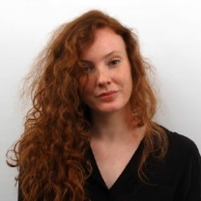
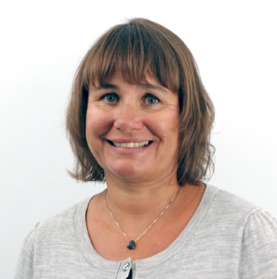
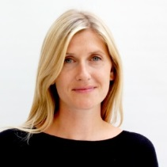
www.nfr.no/naeringsphd
Siri H. Hollekim Haaland shh@rcn.no
+47 47 66 66 26
Kristine Ziegler Gundersen kzg@rcn.no
+47 98 22 35 67
Marie Haaland mha@rcn.no
+47 90 12 39 55
Notes:
Contact us with any questions you may have, and visit our webpage. Thank you!

