Slide 1
Funding opportunities for SME’s – Societal challenges
The unwise man is awake all night,
and ponders everything over;
when morning comes he is weary in mind,
and all is a burden as ever.
Regional Research Fund – Oslo & Akershus
Kjell Øygarden
1. mars 2018

Slide 2
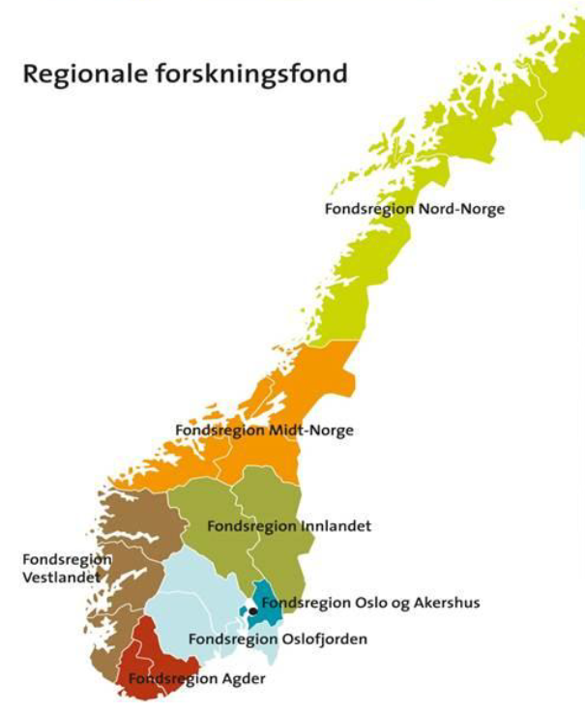
RFF guidelines
Norwegian Ministry of Education and Research
Strengthen research intended to increase and improve regional innovation and regional development
  Increase research based innovation in companies and public sector
  Closer interdisciplinary collaboration between R&D, companies and public sector
Public sector relevant for RFF Oslo & Akershus
  Municipal/county level
  Intermunicipal companies (public owners)

Slide 3

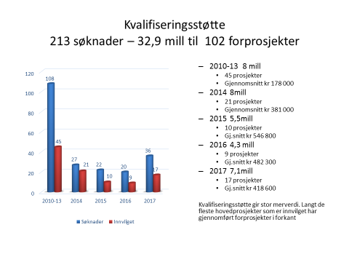
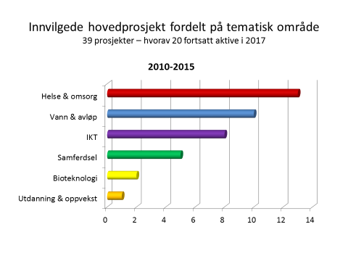
Change of practice
in public sector
Commercial success
for companies
Goals & objectives

Slide 4
Business opportunities based on challenges and needs in public sector
Change of practice
Public sector
Municipal/county level
R&D competence
Market potensial
R&D institutions
Hospitals Universities
R&D institutions
Companies
SME’s
Interdiciplinary projects
Notes:
Strategiske valg – mål for RFFH

Slide 5
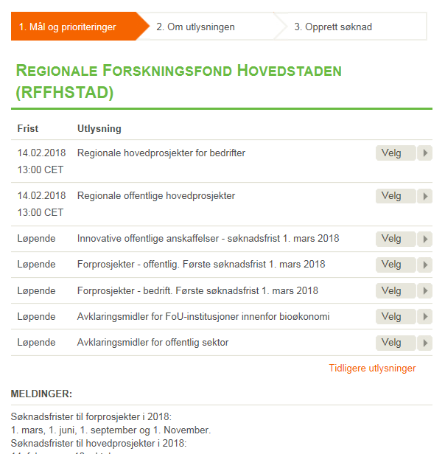
60 mill NOK – Municipal challenges
R&D based innovation projects
  Ed-tech
  Life science
    Bioeconomy
    Med-tech
  ICT – better physical environment and smarter regions
Public procurement
  Ed-tech
  Welfare technology
  Water and wastewater
  Transport
  Digital municipal services
www.regionaleforskningsfond.no/hovedstaden

Slide 6



Challenges and opportunities
Known knowns
Known unknowns
Unknown knowns
Unknown unknowns
Foto: Kjell Øygarden, Kyoto
Notes:
Hva bestemmer vinkelen på grushaugen?

Slide 7

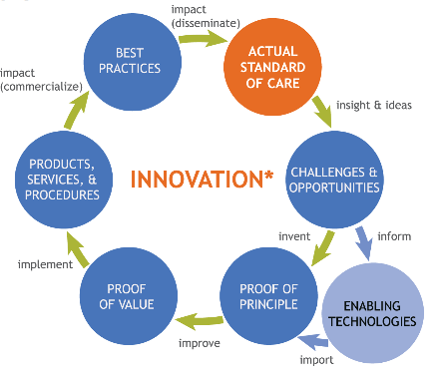


Innovation process

Slide 8
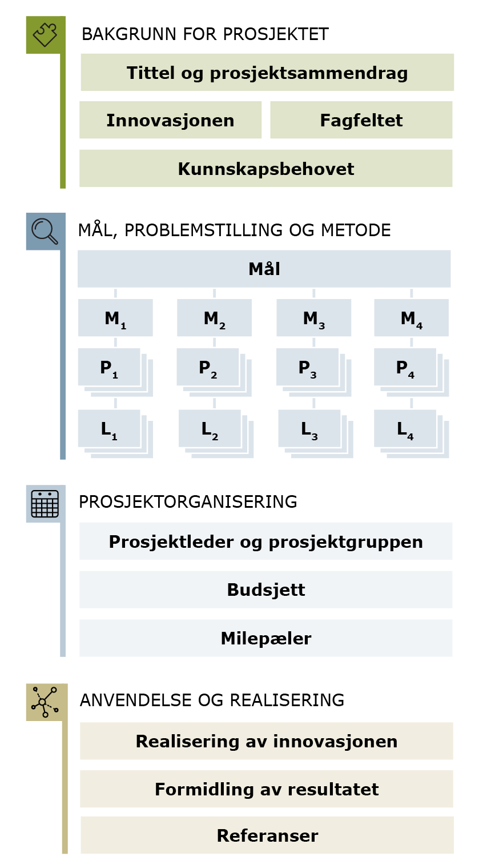
How to write a good story
Impact
Create rationale & enthusiasm
Potential usefulness
Research challenges
Excellence
R&D quality !
Goals and objectives
Research questions
Method and solutions
Implementation
Implementation capacity !
Exploitation of results
Demonstrate usefulness
Notes:
Forskningsspørsmålene synliggjør risiko. Jo høyere potensiell nytteverdi - jo høyere risiko
Vi liker risiko! RFF gir risikoavlastning

Slide 9

He must rise betimes who hath few to serve him,
and see to his work himself;
who sleeps at morning is hindered much,
to the keen is wealth half-won.
Innovation processes are easier to understand in retrospect, but has to be performed in real time!
Success= Innovation has become alive!
Foto: Kjell Øygarden, Haleakala, Maui, Hawaii
Notes:
Lederansvar

