Slide 1
Introduction to EEA and Norway Grants
Knut Ringstad, Innovation Norway

Slide 2
Objectives of the EEA and Norway Grants
Contributing to reducing economic and social disparities in the European Economic Area
Strengthening relations between Iceland, Liechtenstein and Norway and the beneficiary countries
2013-2017: 1.8 billion EUR to programmes in 16 countries
2017-2024: 2.8 billion EUR to programmes in 15 countries

Slide 3
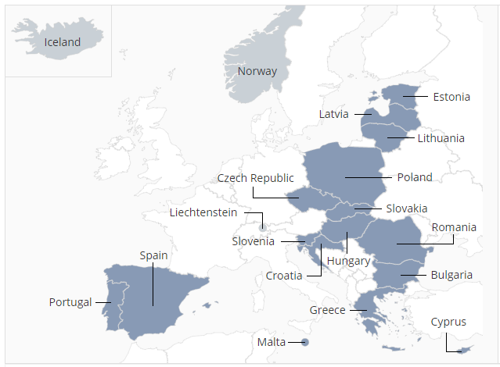
Overview beneficiary and donor countries
(Negotiation ong.)
(Negotiation ong.)
(Negotiation ong.)
(Negotiation ong.)
(Negotiation ong.)
Negotiation ong.

Slide 4
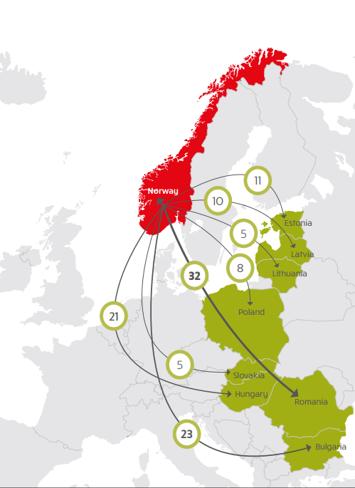
The Past: Green Industry Innovation 2013-2017
Grant amount available
127,7 mill EUR
Projects with partners from donor countries
115
Contributions from donor partners
Sector related know-how
Efficient production processes expertise
Pilot and demonstration projects, incl. equipment
R&D specific support

Slide 5
Some green effects – Green Industry Innovation
Reduced energy consumption / green energy
Reduced emissions ~ 167 000 Norwegian cars a year

Slide 6
Up next – Programme periode 2014-2021 (Project Implementation 2018-24)

Slide 7
Romania
IN operator
Bulgaria
IN operator
Slovakia
IN program partner
Business innovation and education, 20 mill. EUR
Energy 62,8 mill. EUR
Estonia
IN program partner
Business and innovation, 23 mill. EUR
Portugal
IN program partner
Business and innovation, research and education, 38 mill. EUR
Klima og energi 24 mill. EUR
Call late 2018
Call early 2018
Call early 2018
Call early 2018
Business and innovation, 28,5 mill. EUR
Business and innovation, 45 mill. EUR
Call early 2018
2016 * Order of MoU signed * 2017

Slide 8
Greece
IN operator
Latvia
IN program partner
Poland
IN program partner
Business and innovation, 85 mill. EUR
Lithuania
IN program partner
Business and innovation xx mill. EUR
Hungary
IN program partner
Call early 2019
Call early 2019
Call early 2019
Business and innovation, 12,5 mill. EUR
Business and innovation – Green Industry, blue growth, ICT, 21,5 mill. EUR
Call late 2018
Business and innovation, xx mill. EUR
Call early 2019
2017 * Order of MoU signed * 2018

Slide 9
Who can apply?
Target groups in beneficiary countries: private sector
Applicants need to be registered in one of the Beneficiary countries

Slide 10
Who can become project partners?
Registered entities in the donor countries, i.e.
EEA and Norway Grants: Iceland, Liechtenstein, Norway
Norway Grants: Norway
Partners can be private sector, research institutes, universities, NGOs, public institutions

Slide 11
Advice for those who want to get involved with EEA and Norway Grants
Be prepared – know as much as possible about the programme, the market, and business opportunities before the is call launched
Take your time to get to know your future partner well before you sign the contract
Visit the company in the partner country - you can apply for travel support
Make sure there is the economic and financial basis required to take the project to a successful conclusion
Consider participating in an innovative project involving development demonstration and piloting of new solutions, processes and products
Make sure to have sufficient time and resources for the project administration

Slide 12
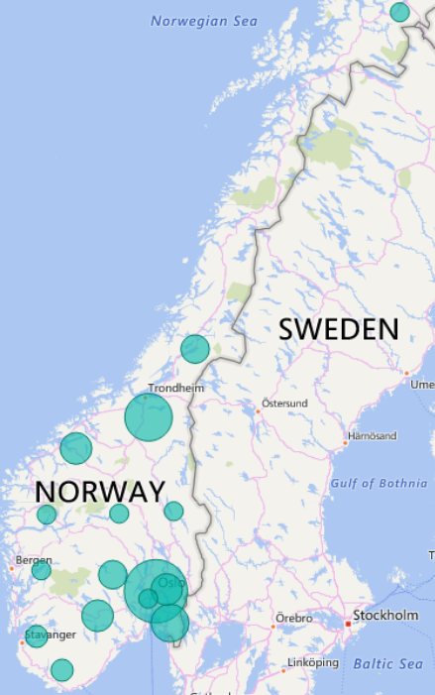
How to find a partner
Websitehttp://www.innovasjonnorge.no/eea-norway-grants -> find a partner Oslo/mottakerland

Slide 13
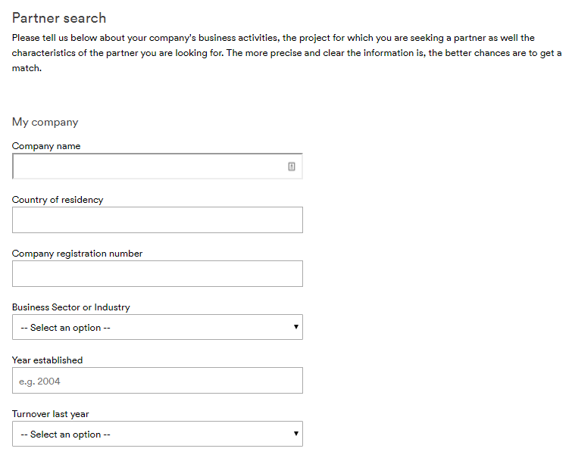
How to find a partner

Slide 14
travel grant EUR 1000 available to Norwegian entities
Bulgaria : Component Welfare Technology and Ambient Assisted Living
October 2017: Visit to Bulgaria by team from Norway Health Tech
Preparation of market assessment report
19 March 2018: Workshop in Oslo on opportunities in Bulgaria
June 2018, launch of programme in Sofia, bilateral workshop/matchmaking Bul –Norwegian companies

Slide 15
Your contact:
Knut Ringstad
Programme Director Poland and Bulgaria
Knut.Ringstad@innovationnorway.no
Telefon: + 41 65 85 24

