Slide 1
ForRegion - for health tech companies Norway Health Tech

Slide 2
ForRegion
Research-driven innovation in the region (FORREGION)
Funding partner: Akershus Fylkeskommune
Main goals
Increased value creation in the industry through research-driven innovation
Strengthen research- and academic communities to support relevant and highly qualified collaboration partners for industry
Mobility between research- and academic inst. and industry
Notes:
March
February
Fin måte å bli kjent med ulike market på. Delta på konferanser, snakke med partnere, bli kjent med kultur og distributører etc.
September Reha Care – Düsseldorf
Leipzig-messen med svenske og norske helsebedrifter B2B først.

Slide 3
ForRegion - maximum 200 000 NOK
Small and large companies can apply
The company must have little or no R&D experience
Outsource R&D activities to relevant R&D institutions
Own contribution/finance 50%
The R&D institution has to be approved by the NRC (on beforehand)
The costs you can apply to get financed are
Purchasing of R&D
Personal and indirect costs
Other operating expences

Slide 4
ForRegion – dates to remember
The call is out from today: 1 March
Deadline for submission of application: 9 April 2018
Submit application to Trine.Radmann@norwayhealthtech.com
«FORREGION Bedriftsprosjekt» in the subject field
Expected feedback on application: 7 May
http://www.norwayhealthtech.com/project/forregion/
Get in touch if you need help/kompetansemegling!

Slide 5
Helse SørØst – utlysning (INNOVASJON)
Who can apply
Hospitals and health institutions
Application through the institution/hospital
Person applying must have at least 20%
Goal with the new solutions
Shorter waiting times
Increased patient safety
Better accessibility
Increased quality
Deadline for applications: 22 March at 4 p.m.
A prerequisite: The budget has been made known to the responsible for the department/unit in the health institutions applying
More information at
www. helse-sorost.no/helsefaglig/innovasjon

Slide 6
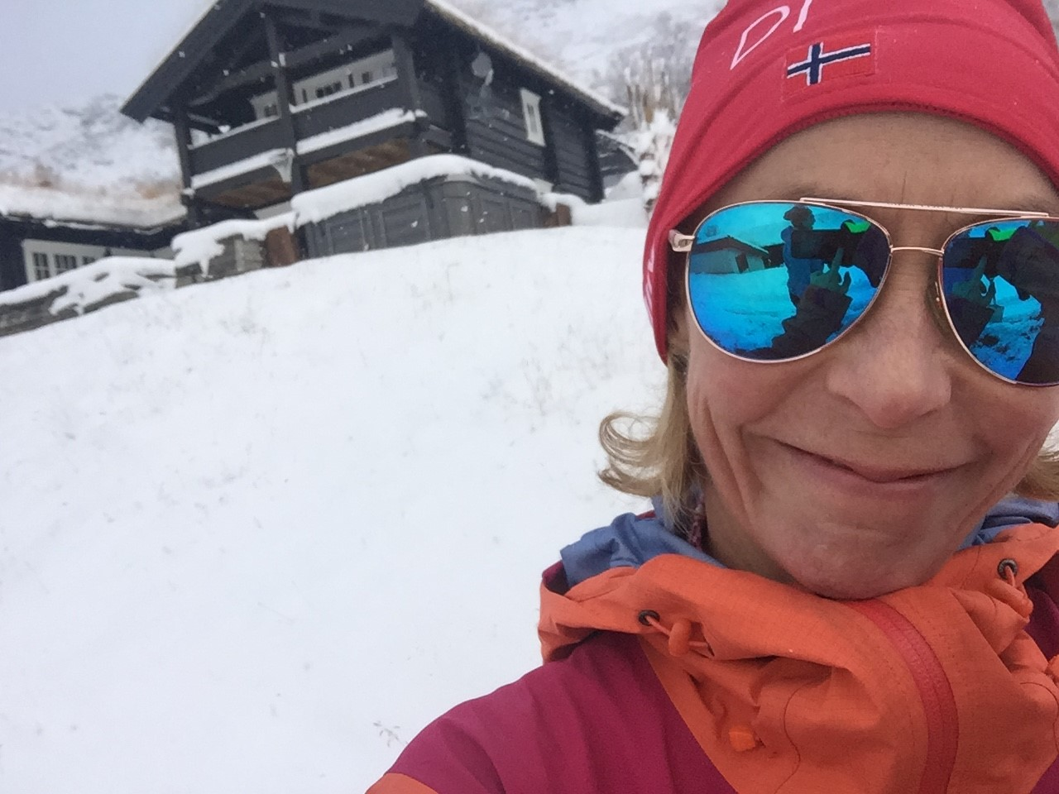
Stay in touch!
www.norwayhealthtech.com
Trine Radmann
Head of International Affairs
tr@norwayhealthtech.com
 +47 992 69285

