Slide 2
Funding opportunities for the Norwegian health industry

Slide 3
The story behind
Oslo Medtech established 2009
Non-profit member organization
Part of Innovation Norway’s cluster program
@ 230 members
Representing the full value chain in members and strategy
NCE – Norwegian Centre of Expertise – status in 2015
Gold Label certification in 2016
Changed name to Norway Health Tech in 2017

Slide 4
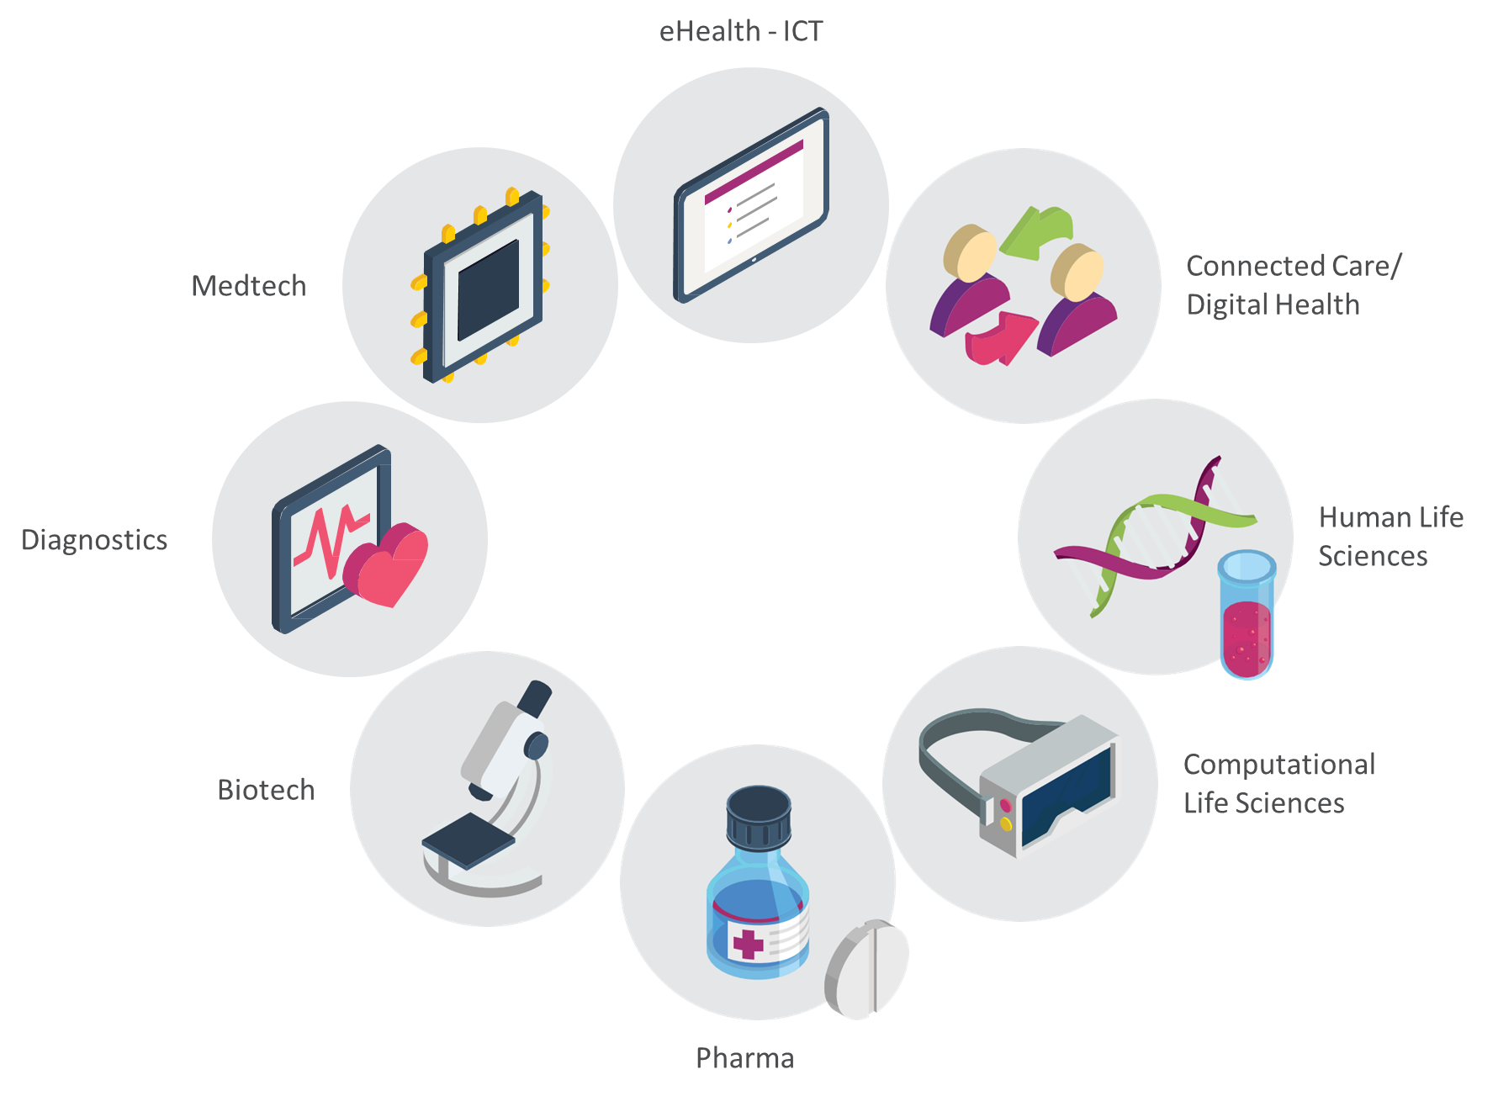
We address all areas of human health

Slide 5
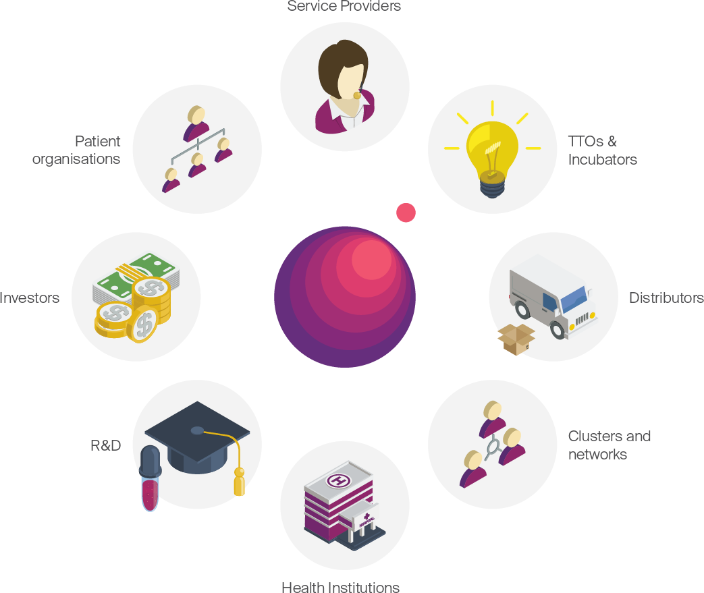
Our members represent the full value chain

Slide 6
Mission
Our mission is to stimulate growth in the Norwegian health industry through our members and national and international eco-system

Slide 7
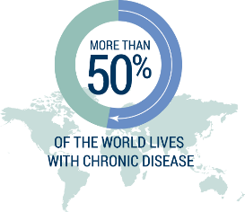
Challenges in healthcare lead to a need for new products and solutions
Less hands
in healthcare
Demographical changes
Need for new products and solutions
Increased occurrence of chronic disease
Norway no 4 on OECD spend per capita/GNP

Slide 8
Norwegian assets in health
Strong R&D, knowledge and data bases
Well established health systems and testbeds
Competence and Technology
Early adaptors, stable economy and trustful relations

Slide 9
The health innovation collaborative ecosystem
The Health Ministry and regional health administration
Health Service Innovation
Competence development
Health Industry
Health Care Providers
Innovation Infrastructure
Network of national and international partners
Disruptive technology and models
National and international public and private financing
Execute Innovation & Acceleration Projects
Acceleration
University research and education collaboration

Slide 10
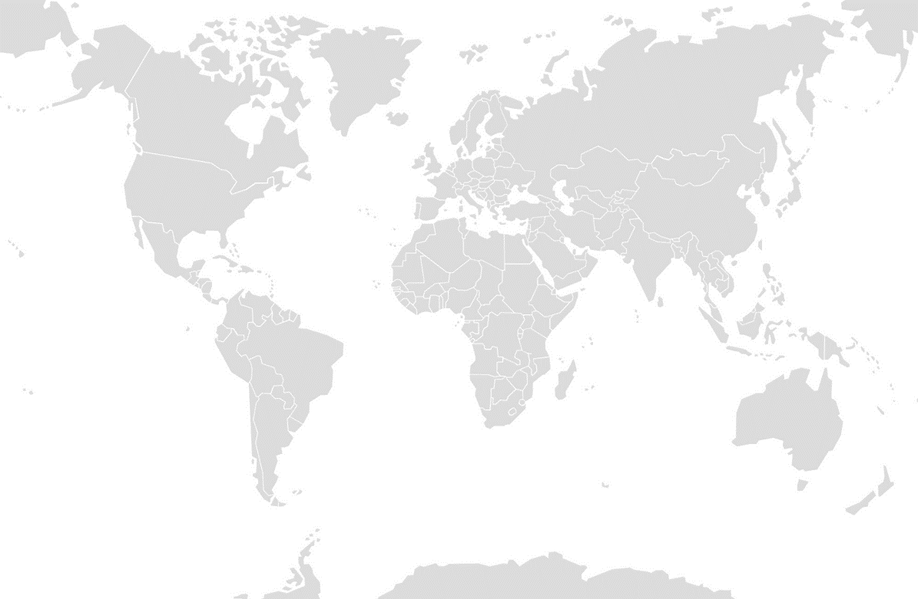
Different funding opportunities for “startup to scaleup”
FT3: International Scaling
Scaled company
FT2: Business Development
Viable business on a limited market and ready to scale
FT1: Business Idea Development
Minimum viable product
Verified business Idea

Slide 11
Collaborating R&D institutions

Slide 13
Mission Our network offers easy access to the most renowned health institutions and testing hubs within healthcare in the Nordics. Professional expertise provides predictability and solid services based on real customer needs.

Slide 14
Nordic Proof
partners

Slide 15
Welcome to Nordic Proof www.nordicproof.org Facebook – Nordic Proof mail@nordicproof.org
Bridging today’s health solutions with the unlimited potential of tomorrow

